Slide 1
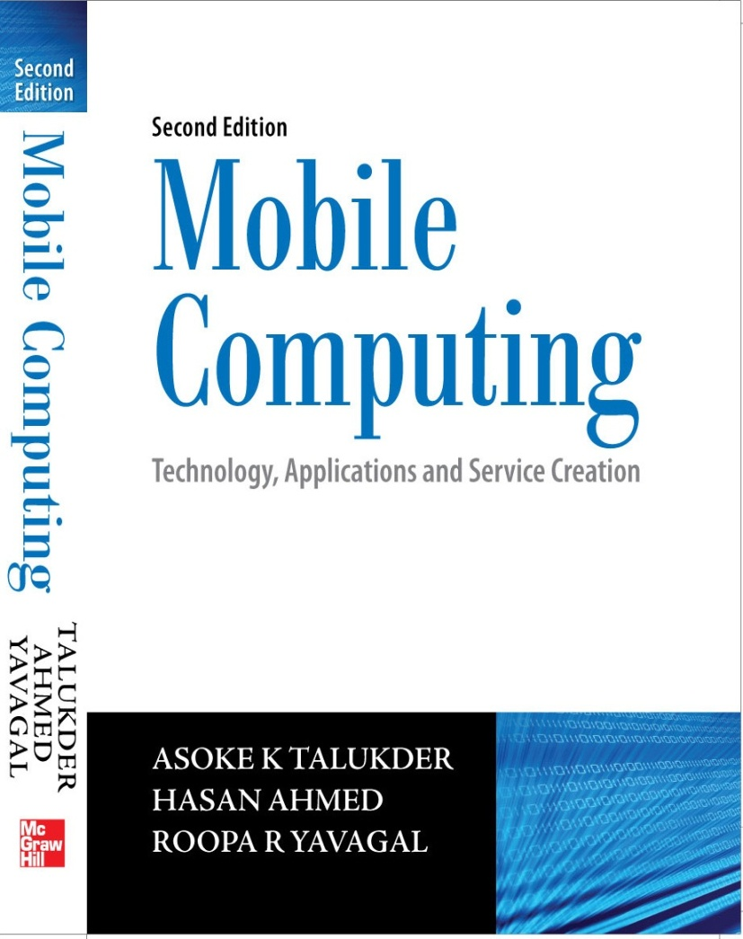
Mobile Computing
Notes#6
GSM

Slide 2
Global System for Mobile Communications
Originally GSM stood for Groupe Speciale Mobile
GSM was designed to meet the following business objectives
Support for international roaming
Good speech quality
Ability to support handheld terminals
Low terminal and service cost
Spectral efficiency
Support for a range of new services and facilities
ISDN compatibility

Slide 3
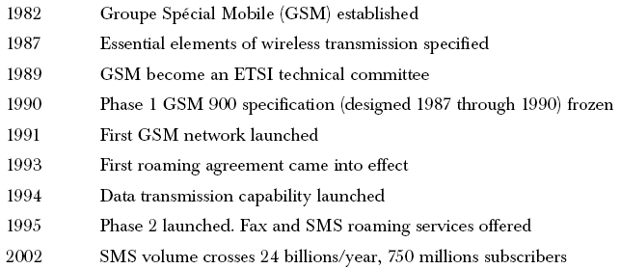
GSM Timeline

Slide 4
Use of TDMA and FDMA in GSM
Uses a combination of FDMA (Frequency Division Multiple Access) and TDMA (Time Division Multiple Access)
Allocation of 50 MHz (890–915 MHz and 935–960 MHz) bandwidth in the 900 MHz frequency band and using FDMA further divided into 124 (125 channels, 1 not used) channels each with a carrier bandwidth of 200 KHz
Using TDMA, each of the above mentioned channels is then further divided into 8 time slots
So, with the combination of FDMA and TDMA, a maximum of 992 channels for transmit and receive can be realized

Slide 5
Frequency reuse in GSM
To serve hundreds of thousands of users, the frequency must be reused and this is done through cells.
The area to be covered is subdivided into radio zones or cells. Though in reality these cells could be of any shape, for convenient modeling purposes these are modeled as hexagons. Base stations are positioned at the center of these cells.
Each cell i receives a subset of frequencies fbi from the total set assigned to the respective mobile network. To avoid any type of co-channel interference, two neighboring cells never use the same frequencies.

Slide 6
Frequency reuse in GSM
Only at a distance of D (known as frequency reuse distance), the same frequency from the set fbi can be reused. Cells with distance D from cell i, can be assigned one or all the frequencies from the set fbi belonging to cell i.
When moving from one cell to another during an ongoing conversation, an automatic channel change occurs. This phenomenon is called handover. Handover maintains an active speech and data connection over cell boundaries.
The regular repetition of frequencies in cells result in a clustering of cells. The clusters generated in this way can consume the whole frequency band. The size of a cluster is defined by k, the number of cells in the cluster. This also defines the frequency reuse distance D. The figure in next slide shows an example of cluster size of 4.

Slide 7
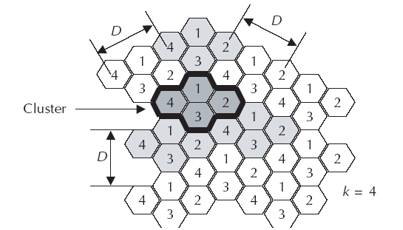
Cell clusters in GSM

Slide 8
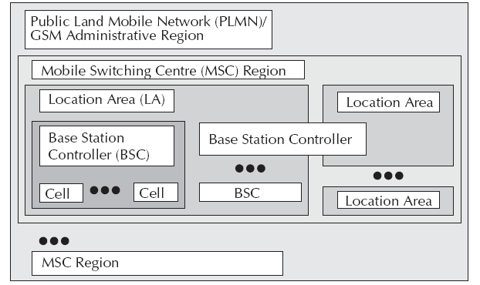
GSM System Hierarchy

Slide 9
GSM System Hierarchy
Consists at the minimum one administrative region assigned to one MSC (Mobile Switching Centre)
Administrative region is commonly known as PLMN (Public Land Mobile Network)
Each administrative region is subdivided into one or many Location Area (LA)
One LA consists of many cell groups and each cell group is assigned to one BSC (Base Station Controller)
For each LA, there will be at least one BSC while cells in one BSC can belong to different LAs

Slide 10
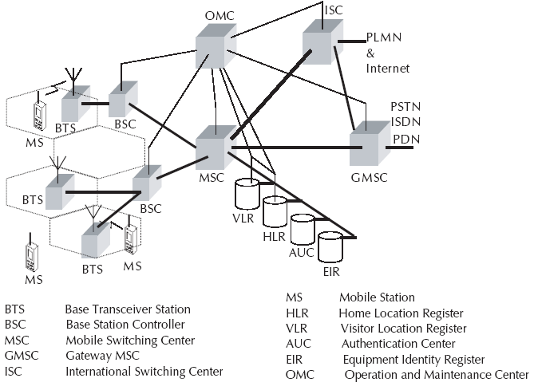
GSM Architecture

Slide 11
GSM Architecture
Cells are formed by the radio areas covered by a BTS (Base Transceiver Station)
Several BTSs are controlled by one BSC
Traffic from the MS (Mobile Station) is routed through MSC
Calls originating from or terminating in a fixed network or other mobile networks is handled by the GMSC (Gateway MSC)

Slide 12
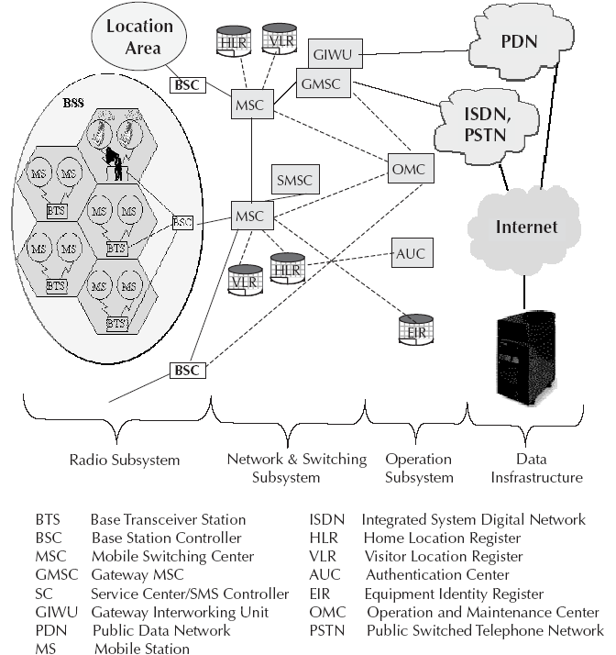
Operational Architecture of GSM

Slide 13
Home Location Register (HLR) in GSM
It contains the following information:
Authentication information like International Mobile Subscriber Identity (IMSI)
Identification information like name, address, etc. of the subscriber
Identification information like Mobile Subscriber ISDN (MSISDN) etc.
Billing information like prepaid or postpaid
Operator selected denial of service to a subscriber

Slide 14
Home Location Register (HLR) in GSM
Handling of supplementary services like for CFU (Call Forwarding Unconditional), CFB (Call Forwarding Busy), CFNR (Call Forwarding Not Reachable) or CFNA (Call Forwarding Not Answered)
Storage of SMS Service Center (SC) number in case the mobile is not connectable so that whenever the mobile is connectable, a paging signal is sent to the SC
Provisioning information like whether long distance and international calls allowed or not
Provisioning information like whether roaming is enabled or not

Slide 15
Home Location Register (HLR) in GSM
Information related to auxiliary services like Voice mail, data, fax services, etc.
Information related to auxiliary services like CLI (Caller Line Identification), etc.
Information related to supplementary services for call routing. In GSM network, one can customize the personal profile to the extent that while the subscriber is roaming in a foreign PLMN, incoming calls can be barred. Also, outgoing international calls can be barred, etc.
Some variable information like pointer to the VLR, location area of the subscriber, Power OFF status of the handset, etc.

Slide 16
Entities in GSM
The Mobile Station (MS) - This includes the Mobile Equipment (ME) and the Subscriber Identity Module (SIM).
The Base Station Subsystem (BSS) - This includes the Base Transceiver Station (BTS) and the Base Station Controller (BSC).
The Network and Switching Subsystem (NSS) - This includes Mobile Switching Center (MSC), Home Location Register (HLR), Visitor Location Register (VLR), Equipment Identity Register (EIR), and the Authentication Center (AUC).
The Operation and Support Subsystem (OSS) - This includes the Operation and Maintenance Center (OMC).

Slide 17
Mobile Station
Mobile Station (MS) consists of two main elements: mobile equipment or mobile device (that is the phone without the SIM card) and Subscriber Identity Module (SIM)
Terminals distinguished principally by their power and application
SIM is installed in every GSM phone and identifies the terminal
SIM cards used in GSM phones are smart processor cards with a processor and a small memory
SIM card contains the International Mobile Subscriber Identity (IMSI) used to identify the subscriber to the system, a secret key for authentication, and other security information

Slide 18
Base Station Subsystem
Base Station Subsystem (BSS) connects the Mobile Station and the Network and Switching Subsystem (NSS)
In charge of the transmission and reception for the last mile
BSS can be divided into two parts: Base Transceiver Station (BTS) or Base Station and Base Station Controller (BSC)
Base Transceiver Station corresponds to the transceivers and antennas used in each cell of the network
BTS is usually placed in the center of a cell and its transmitting power defines the size of a cell

Slide 19
Base Station Subsystem
BTS houses the radio transmitter and the receivers that define a cell and handles the radio-link protocols with the Mobile Station while handling between one and sixteen transceivers depending on the density of users in the cell
Base Station Controller is the connection between the BTS and the Mobile service Switching Center (MSC) and manages the radio resources for one or more BTSs
BSC handles handovers, radio-channel setup, control of radio frequency power levels of the BTSs, exchange function, and the frequency hopping

Slide 20
Network and Switching Subsystem
Central component of the Network Subsystem is the Mobile Switching Center (MSC)
Signaling between functional entities in the Network Subsystem uses Signaling System Number 7 (SS7)
MSC together with Home Location Register (HLR) and Visitor Location Register (VLR) databases, provide the call-routing and roaming capabilities of GSM
MSC does the following functions:
It acts like a normal switching node for mobile subscribers of the same network (connection between mobile phone to mobile phone within the same network)

Slide 21
Network and Switching Subsystem
It acts like a normal switching node for the PSTN fixed telephone (connection between mobile phone to fixed phone)
It acts like a normal switching node for ISDN
It provides all the functionality needed to handle a mobile subscriber, such as registration, authentication, location updating, handovers and call routing
It includes databases needed in order to store information to manage the mobility of a roaming subscriber

Slide 22
Network Switching Subsystem
MSC together with Home Location Register (HLR) and Visitor Location Register (VLR) databases, provide the call-routing and roaming capabilities of GSM
HLR contains all the administrative information of each subscriber registered in the corresponding GSM network
Location of the mobile is typically in the form of the signaling address of the VLR associated with the mobile station
HLR is always fixed and stored in the home network, whereas the VLR logically moves with the subscriber
VLR is similar to a cache, whereas HLR is the persistent storage

Slide 23
Network and Switching Subsystem
VLR contains selected administrative information borrowed from the HLR, necessary for call control and provisioning of the subscribed services
When a subscriber enters the covering area of a new MSC, the VLR associated with this MSC can request information about the new subscriber from its corresponding HLR in the home network
There is a component called Gateway MSC (GMSC) that is associated with the MSC

Slide 24
Network and Switching Subsystem
GMSC is the interface between the mobile cellular network and the PSTN and also is in charge of routing calls from the fixed network towards a GSM user and vice versa
GMSC is often implemented in the same node as the MSC
GIWU (GSM Inter Working Unit) corresponds to an interface to various networks for data communications

Slide 25
Operation and Support Subsystem
Operations and Support Subsystem (OSS) controls and monitors the GSM system
OSS is connected to the different components of the NSS and to the BSC and also in charge of controlling the traffic load of the BSS
Equipment Identity Register (EIR) rests with OSS
EIR is a database that contains a list of all valid mobile equipment within the network, where each mobile station is identified by its International Mobile Equipment Identity (IMEI)
EIR contains a list of IMEIs of all valid terminals

Slide 26
Operation and Support Subsystem
An IMEI is marked as invalid if it has been reported stolen or is not type approved
The EIR allows the MSC to forbid calls from this stolen or unauthorized terminals
Authentication Center (AUC) is responsible for the authentication of a subscriber
AUC is a protected database and stores a copy of the secret key stored in each subscriber’s SIM card

Slide 27
Short Message Service
Short Message Service (SMS) is one of the most popular services within GSM
SMS is a data service and allows a user to enter text message up to 160 characters in length when 7 bit English characters are used
SMS is a proactive bearer and is an ‘always on’ network
Message center is referred to as Service Centre (SC) or SMS Controller (SMSC)
SMSC is a system within the core GSM network which works as the store and forward system for SMS messages

Slide 28
SMS
Two types of SMS: SMMT (Short Message Mobile Terminated Point-to-Point) and SMMO (Short Message Mobile Originated Point-to-Point)
SMMT is an incoming short message from the network and is terminated in the MS (phone or Mobile Station)
SMMO is an outgoing message originated in the MS, and forwarded to the network for delivery
For an outgoing message, the SMS is sent from the phone to SC via the VLR and the Inter Working MSC (IWMSC)
For incoming message, the path is from SC to the MS via the HLR and the Gateway MSC (GMSC)

Slide 29
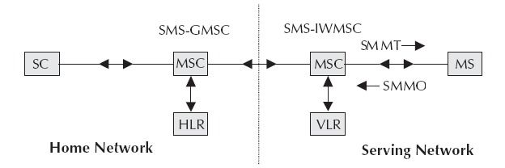
SMS Transfer

Slide 30
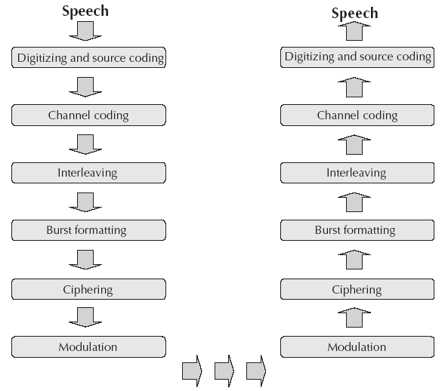
From speech to radio waves

Slide 31
From speech to radio waves
Digitizer and source coding: The user speech is digitized at 8 KHz sampling rate using Regular Pulse Excited–Linear Predictive Coder (RPE–LPC) with a Long Term Predictor loop where information from previous samples is used to predict the current sample. Each sample is then represented in signed 13-bit linear PCM value. This digitized data is passed to the coder with frames of 160 samples where encoder compresses these 160 samples into 260-bits GSM frames resulting in one second of speech compressed into 1625 bytes and achieving a rate of 13 Kbits/sec.

Slide 32
From speech to radio waves
Channel coding: This introduces redundancy into the data for error detection and possible error correction where the gross bit rate after channel coding is 22.8 kbps (or 456 bits every 20 ms). These 456 bits are divided into eight 57-bit blocks and the result is interleaved amongst eight successive time slot bursts for protection against burst transmission errors.
Interleaving: This step rearranges a group of bits in a particular way to improve the performance of the error-correction mechanisms. The interleaving decreases the possibility of losing whole bursts during the transmission by dispersing the errors.
Ciphering: This encrypts blocks of user data using a symmetric key shared by the mobile station and the BTS.

Slide 33
From speech to radio waves
Burst formatting: It adds some binary information to the ciphered block for use in synchronization and equalization of the received data.
Modulation: The modulation technique chosen for the GSM system is the Gaussian Minimum Shift Keying (GMSK) where binary data is converted back into analog signal to fit the frequency and time requirements for the multiple access rules. This signal is then radiated as radio wave over the air.
Multipath and equalization: An equaliser is in charge of extracting the ‘right’ signal from the received signal while estimating the channel impulse response of the GSM system and then it constructs an inverse filter. The received signal is then passed through the inverse filter.

Slide 34
From speech to radio waves
Synchronization: For successful operation of a mobile radio system, time and frequency synchronization are needed. Frequency synchronization is necessary so that the transmitter and receiver frequency match (in FDMA) while Time synchronization is necessary to identify the frame boundary and the bits within the frame (in TDMA).
To avoid collisions of burst transmitted by MS with the adjacent timeslot such collisions, the Timing Advance technique is used where frame is advanced in time so that this offsets the delay due to greater distance. Using this technique and the triangulation of the intersection cell sites, the location of a mobile station can be determined from within the network.

Slide 35
Call Routing
The directory number dialed to reach a mobile subscriber is called the Mobile Subscriber ISDN (MSISDN) which is defined by the E.164 numbering plan and includes a country code and a National Destination Code, which identifies the subscriber’s operator. The first few digits of the remaining subscriber number may identify the subscriber’s HLR within the home PLMN
For example, the MSISDN number of a subscriber in Bangalore associated with Airtel network is +919845XYYYYY which is a unique number and understood from anywhere in the world. Here, + means prefix for international dialing, 91 is the country code for India and 45 is the network operator’s code (Airtel in this case). X is the level number managed by the network operator ranging from 0 to 9 while YYYYY is the subscriber code which , too, is managed by the operator.

Slide 36
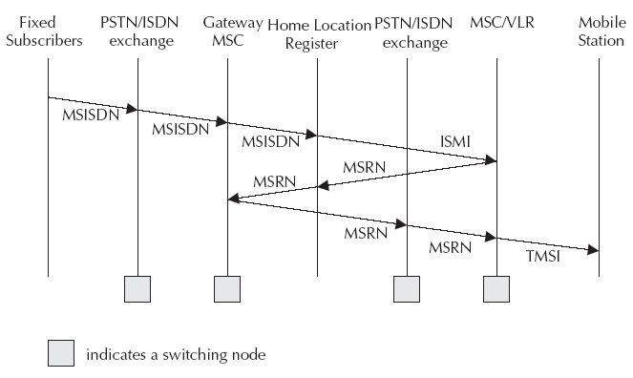
Call Routing

Slide 37
Call Routing
The call first goes to the local PSTN exchange where PSTN exchange looks at the routing table and determines that it is a call to a mobile network.
PSTN forwards the call to the Gateway MSC (GMSC) of the mobile network.
MSC enquires the HLR to determine the status of the subscriber. It will decide whether the call is to be routed or not. If MSC finds that the call can be processed, it will find out the address of the VLR where the mobile is expected to be present.

Slide 38
Call Routing
If VLR is that of a different PLMN, it will forward the call to the foreign PLMN through the Gateway MSC. If the VLR is in the home network, it will determine the Location Area (LA).
Within the LA, it will page and locate the phone and connect the call.

Slide 39
Public Land Mobile Network (PLMN) Interfaces
Basic configuration of a GSM network contains a central HLR and a central VLR where HLR contains all security, provisioning and subscriber related information and VLR stores the location information and other transient data.
MSC needs subscriber parameter for successful call set-up.
Any data related to user call (connection, teardown etc.) are processed with SS7 protocol for signaling using ISUP (ISDN User Part) stack between network nodes.
For mobile specific signaling, a protocol stack called MAP (Mobile Application Part) is used over the SS7 network which does all database transactions and handover/roaming transactions between the MSC.

Slide 40
GSM Addresses and Identifiers
International Mobile Station Equipment Identity (IMEI): Every mobile equipment in this world has a unique identifier which is called IMEI. IMEI is allocated by the equipment manufacturer and registered by the network operator in the Equipment Identity Register (EIR).
International Mobile Subscriber Identity (IMSI): When registered with a GSM operator, each subscriber is assigned a unique identifier called IMSI which is stored in the SIM card and secured by the operator. IMSI consists of several parts: 3 decimal digits of Mobile Country Code (MCC), 2 decimal digits of Mobile Network Code (MNC) and a maximum of 10 decimal digits of Mobile Subscriber Identification Number (MSIN) which is a unique number of the subscriber within the home network.

Slide 41
GSM Addresses and Identifiers
Mobile Subscriber ISDN Number (MSISDN): The MSISDN number is the real telephone number as is known to the external world. MSISDN number is public information whereas IMSI is private to the operator. IMSI can be multiple such as when a subscriber opts for fax and data, he is assigned a total of three numbers: one for voice call, one for fax call and another for data call. MSISDN follows the international ISDN (Integrated Systems Data Network) numbering plan.
ISDN has Country Code (CC) of 1 to 3 decimal digits, National Destination Code (NDC) of 2 to 3 decimal digits and Subscriber Number (SN) of maximum 10 decimal digits.

Slide 42
GSM Addresses and Identifiers
Location Area Identity: Each LA in a PLMN has its own identifier called Location Area Identifier (LAI) which is structured hierarchically and unique. LAI consists of 3 digits of CC, 2 digits of Mobile Network Code and maximum of 5 digits of Location Area Code.
Mobile Station Roaming Number (MSRN): When a subscriber is roaming in another network, a temporary ISDN number is assigned to the subscriber called MSRN. MSRN is assigned by the local VLR in charge of the mobile station and follows the structure of MSISDN.

Slide 43
GSM Addresses and Identifiers
Temporary Mobile Subscriber Identity (TMSI): TMSI is a temporary identifier assigned by the serving VLR used in place of the IMSI for identification and addressing of the mobile station. Together with the current location area, a TMSI allows a subscriber to be identified uniquely.
Local Mobile Subscriber Identity (LMSI): LMSI is assigned by the VLR and stored in the HLR and is used as a searching key for faster database access within the VLR.
Cell Identifier: Within a LA, every cell has a unique Cell Identifier (CI) and together with a LAI, a cell can be identified uniquely through Global Cell Identity (LAI & CI).
MSCs and Location Registers (HLR & VLR) are addressed with ISDN numbers while they may use a Signaling Point Code (SPC) within a PLMN.

Slide 44
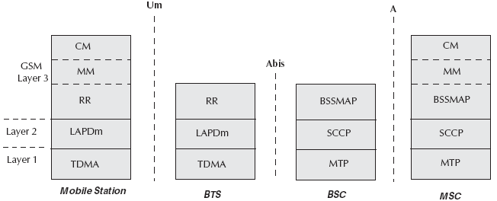
Network aspects in GSM
Signaling protocol structure in GSM

Slide 45
Network aspects in GSM
Layer 1 is the physical layer which uses the channel structures over the air interface.
Layer 2 is the data link layer and across the Um interface, the data link layer is a modified version of the LAPD protocol used in ISDN or X.25, called LAPDm.
Across the A interface, the Message Transfer Part layer 2 of Signaling System Number 7 is used.

Slide 46
Network aspects in GSM
Layer 3 of the GSM signaling protocol is itself divided into three sub-layers:
Radio Resources Management: It controls the set-up, maintenance and termination of radio and fixed channels, including handovers.
Mobility Management: It manages the location updating and registration procedures as well as security and authentication.
Connection Management: It handles general call control and manages Supplementary Services and the Short Message Service.

Slide 47
Handover
The procedure of change of resources is called handover when the user is mobile while the call is in progress.
There are four different types of handover in the GSM system, which involve transferring a call between:
Channels (time slots) in the same cell
Cells (Base Transceiver Stations) under the control of the same Base Station Controller (BSC)
Cells under the control of different BSCs but belonging to the same Mobile Switching Center (MSC)
Cells under the control of different MSCs

Slide 48
Handover
First two types of handover, called internal handovers, involve only one Base Station Controller (BSC). To save signaling bandwidth, they are managed by the BSC without involving the Mobile services Switching Center (MSC), except to notify it at the completion of the handover.
Last two types of handover, called external handovers, are handled by the MSC.

Slide 49
Mobility Management
Mobility Management (MM) function handles the procedures that arise from the mobility of the subscriber and is in charge of all the aspects related to the mobility of the user, especially the roaming, the location management, and the security/authentication of the subscriber.
First location update procedure is called the IMSI attach procedure where the MS indicates its IMSI to the network whereas when a mobile station is powered off, it performs an IMSI detach procedure in order to tell the network that it is no longer connected.

Slide 50
Mobility Management
A location update message is sent to the new MSC/VLR which records the location area information and then sends the location information to the subscriber’s HLR.
If the mobile station is authenticated and authorized in the new MSC/VLR, the subscriber’s HLR cancels the registration of the mobile station with the old MSC/VLR.
Location update is also performed periodically and if after the updating time period, the mobile station has not registered, it is then deregistered.

Slide 51
Mobility Management
When there is an incoming call for a subscriber, the mobile phone needs to be located and a channel needs to be allocated and the call connected.
A powered-on mobile is informed of an incoming call by a paging message sent over the paging channel of the cells within the current location area while location updating procedures and subsequent call routing use MSC, HLR and VLR.
If the subscriber is entitled to service, HLR sends a subset of the subscriber information needed for call control to the new MSC/VLR and sends a message to the old MSC/VLR to cancel the old registration.

Slide 52
Mobility Management
An incoming mobile terminating call is directed to the Gateway MSC (GMSC) function which, as a switch, interrogates the subscriber’s HLR to obtain routing information and thus contains a table linking MSISDNs to their corresponding HLRs.
The routing information that is returned to the GMSC is the Mobile Station Roaming Number (MSRN).
MSRNs are related to the geographical numbering plan and not visible to subscribers.

Slide 53
Mobility Management
Generally, GMSC queries the called subscriber’s HLR for an MSRN.
HLR stores only the SS7 address of the subscriber’s current VLR while VLR temporarily allocates an MSRN from its pool for the call.
MSRN is returned to the HLR and back to the GMSC, which can then route the call to the new MSC. At new MSC, IMSI corresponding to the MSRN is looked up and the mobile station is paged in its current location area.
HLR is referred for incoming call whereas VLR is referred for outgoing call.

Slide 54
GSM Frequency Allocation
Normally, GSM uses 900 MHz band wherein 890-915 MHz is allocated for the uplink (mobile station to base station) and 935–960 MHz is allocated for the downlink (base station to mobile station). Each way the bandwidth for the GSM system is 25 MHz which provides 125 carriers uplink/downlink each having a bandwidth of 200 kHz.
ARFCN (Absolute Radio Frequency Channel Numbers) denote a forward and reverse channel pair which is separated in frequency by 45 MHz.
Practically, a guard band of 100 kHz is provided at the upper and lower end of the GSM 900 MHz spectrum and only 124 (duplex) channels are implemented.

Slide 55
GSM Frequency Allocation
GSM uses a combination of Time Division Multiple Access (TDMA) and Frequency Division Multiple Access (FDMA) encoding.
One or more carrier frequencies are assigned to each base station and each of these carrier frequencies is then divided in time using a TDMA scheme where fundamental unit is called a burst period lasting approximately 0.577 ms.
Eight burst periods are grouped into a TDMA frame of approximately 4.615 ms which forms the basic unit for the definition of logical channels.
One physical channel is one burst period per TDMA frame while, normally, channels are defined by the number and position of their corresponding burst periods.

Slide 56
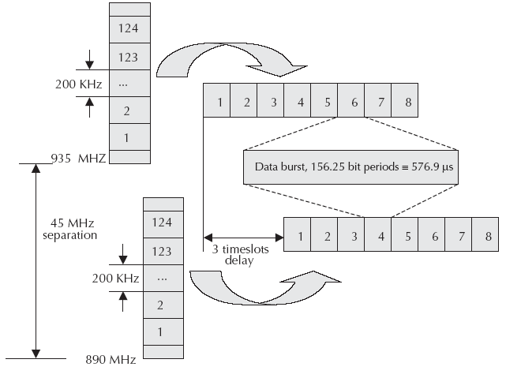
GSM Frequency Allocation
Carrier frequencies and TDMA frames

Slide 57
Authentication and Security
Authentication involves two functional entities - the SIM card in the mobile phone and the Authentication Center (AUC).
Following authentication by algorithm A3, a key is generated for encryption.
An algorithm A8 is used to generate the key while a different algorithm called A5 is used for both ciphering and deciphering procedures for signaling, voice and data.
So, SS7 signal, voice, data, and SMS within GSM networks are ciphered over the wireless radio interface.

Slide 58
A3 Algorithm
During authentication, MSC challenges the MS with a random number (RAND).
SIM card uses this RAND received from the MSC and a secret key Kj stored within the SIM as input. Both the RAND and the Kj secret are 128 bits long. Using the A3 algorithm with RAND and Kj as input a 32-bit output called signature response (SRES) is generated in the MS and then sent back to MSC.
Using the same set of algorithms, the AUC also generates a SRES. The SRES from MS and the SRES generated by the AUC are compared.
If they are the same, the MS is authenticated.

Slide 59
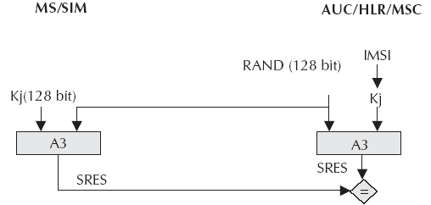
A3 Algorithm
The idea is that no keys will be transacted over the air. However, if the SRES values calculated independently by the SIM and the AUC are the same, then Kj has to be same and if Kj is same, SIM card is genuine.

Slide 60
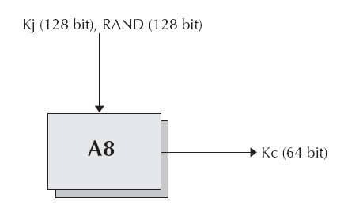
A8 Algorithm
A8 algorithm is the key generation algorithm.
A8 generates a session key, Kc, from the random challenge RAND (received from the MSC) and from the secret key Kj.
Keys are generated at both the MS and the network end. The session key, Kc, is used for ciphering till the MSC decides to authenticate the MS once again.

Slide 61
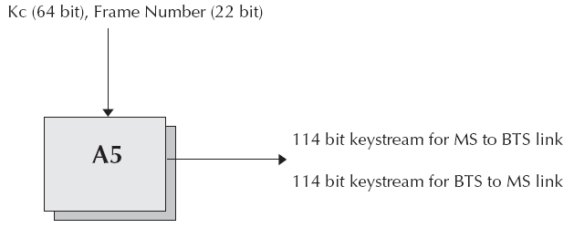
A5 Algorithm
A5 is the stream cipher algorithm used to encrypt over-the-air transmissions. The stream cipher is initialized all over again for every frame sent with the session key, Kc, and the number of the frame being encrypted or decrypted.
Same Kc is used throughout the call but the 22-bit frame number changes during the call, thus, generating a unique key stream for every frame.

Slide 62
Next Chapter
Short Message Service
Thanks

